Slide 1
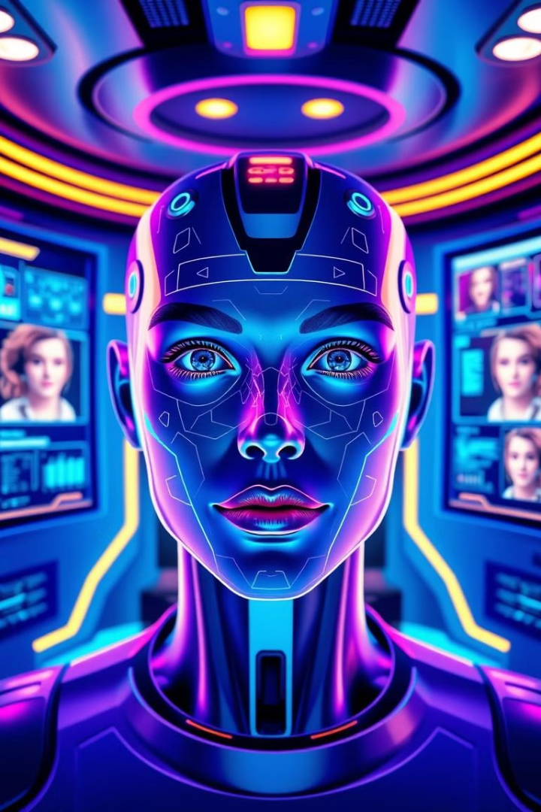
Face Recognition Web App
de
by daniel endale

Slide 2

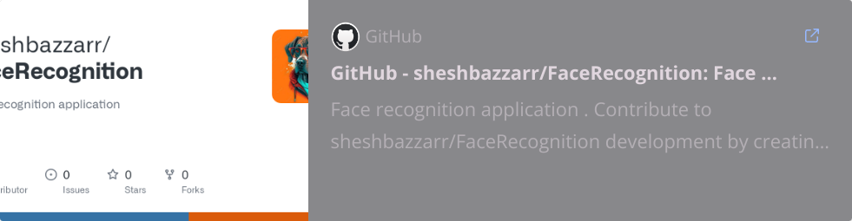
Team Members
This is a solo project that I will develop entirely by myself,handling all aspects of the process, including the machine learning model, API development, and front-end integration.
I will be developing a comprehensive face recognition web application from scratch, integrating machine learning, API development, and a user-friendly front-end. This presentation will guide you through the project's details, key features, and the exciting possibilities of AI.

Slide 3
Project Description
1
Face Recognition Web App
2
Machine Learning Integration
3
User-Friendly Interface
The front-end will be intuitive and easy to use for users.
This web application will identify individuals based on their facial features.
A trained machine learning model will power the facial recognition engine.
Prepare test image
Face Registration
Face Identification
Insights
Prepare image that will be test ,access the face recognition system.
Upload your face data to enroll in the system.
Match uploaded images against registered faces.
View accuracy and model performance metrics.

Slide 4
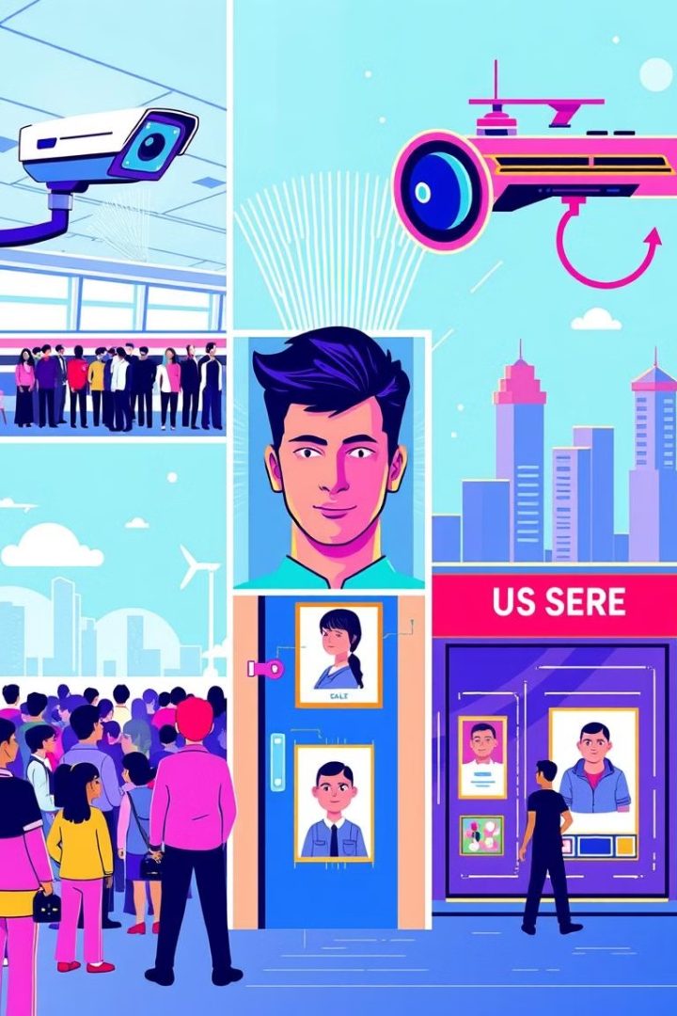
Project Purpose
End-to-End Development
Accessibility
Provide users with an easy-to-use face recognition platform.
Build an application integrating machine learning and web development.
AI Potential
Practical Use Cases
Highlight the capabilities of machine learning in real-world applications.
Enable potential deployment in access control, security, and personalization systems.

Slide 5




Learning Objectives
Master Machine Learning
1
Train and optimize face recognition models.
Integrate with Web Development
2
Build a Flask API to serve the model.
Enhance Technical Skills
3
Work with Python, Flask, and front-end technologies.
Deployment
4
Deploy the it in Railway and render

Slide 6





Technologies Used
Programming Languages
Frameworks & Libraries
Database
Platforms
Flask
None (for now )
Render or Railway app, Heroku (for deployment)
HTML
OpenCV
Bootstrap
dlib
Python
Scikit-learn
Matplotlib

Slide 7
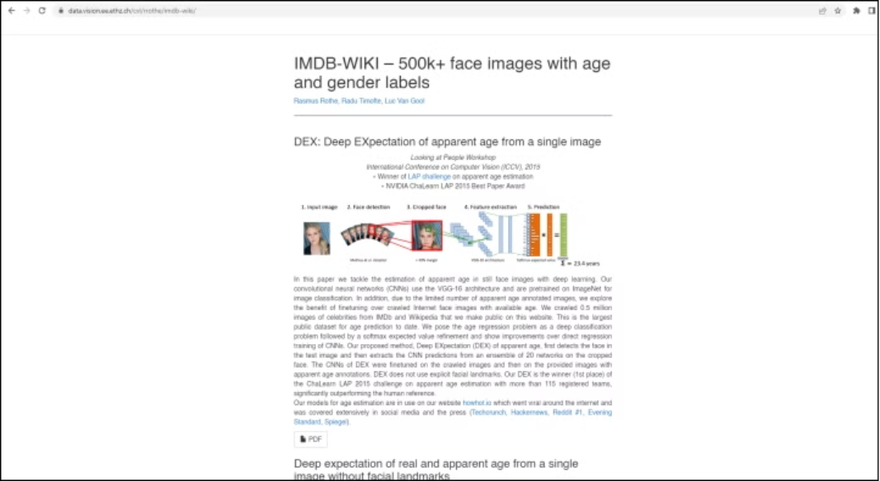
Dataset :IMDB WIKI 500k+face image
URL: https://data.vision.ee.ethz.ch/cvl/rrothe/imdb-wiki/

Slide 8
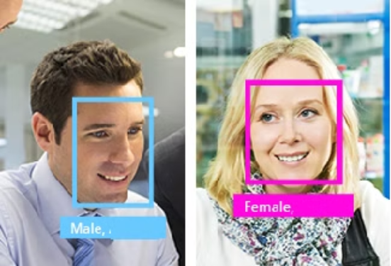
End to End Face Recognition App
The main purpose of the app is to identify gender from face (male/female)

Slide 9
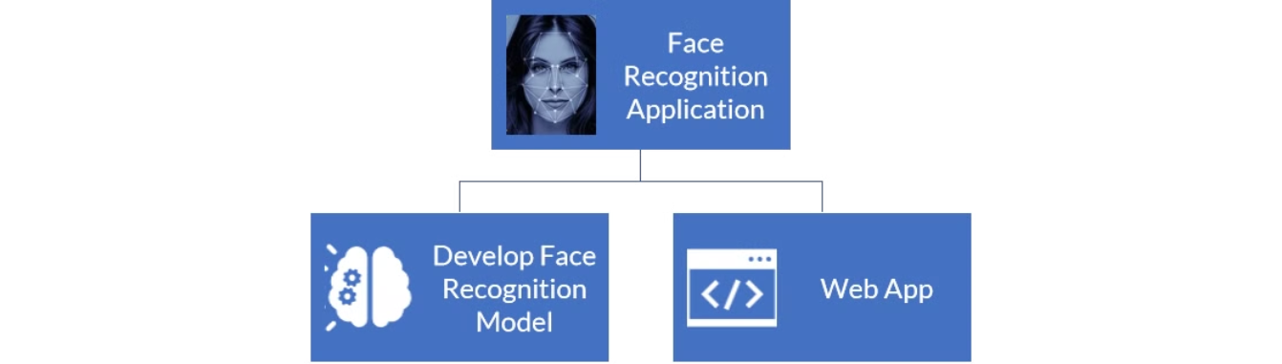
End to End Face Recognition App
► Data Analysis
► Create Face Recognition Web App in Flask (API)
► Data Pre-processing
► Deploy Flask app into production
► Train Machine Learning Model
► Create Pipeline Mode
l

Slide 10
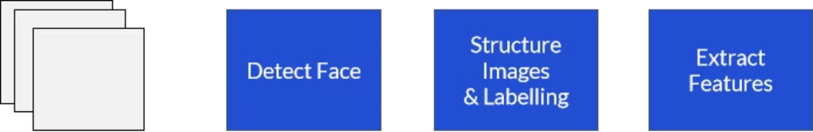
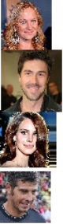
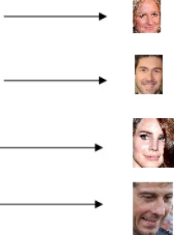
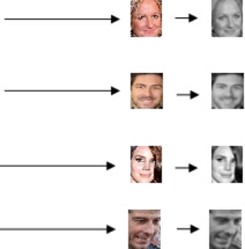
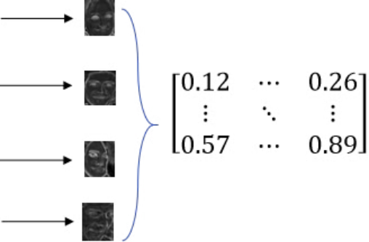
Training flow

Slide 11
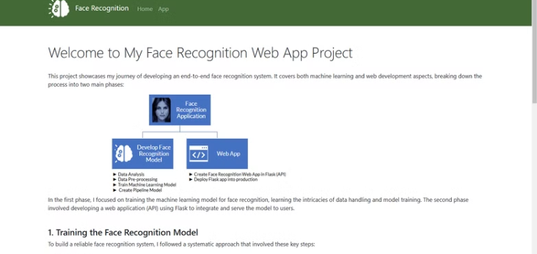
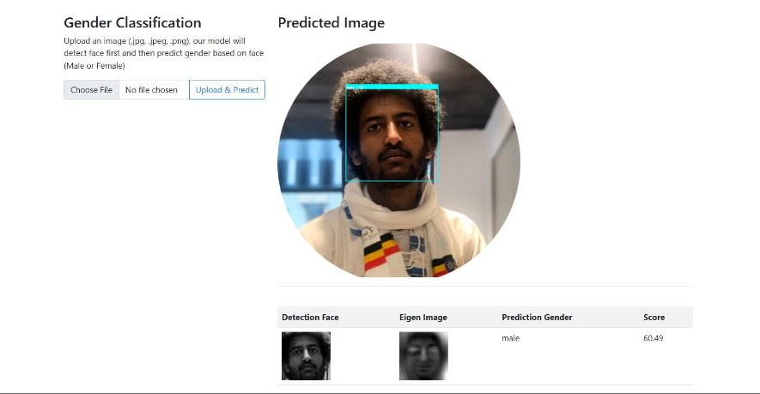
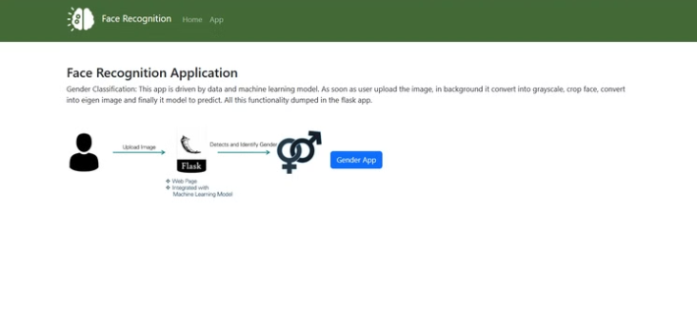
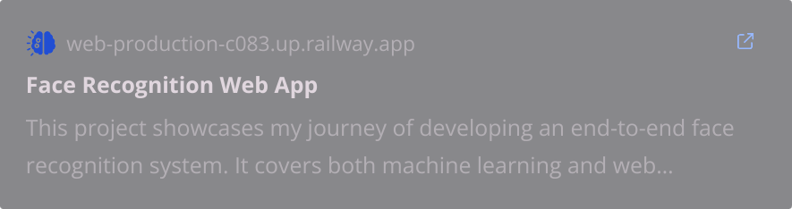
Pages and APP

Slide 12
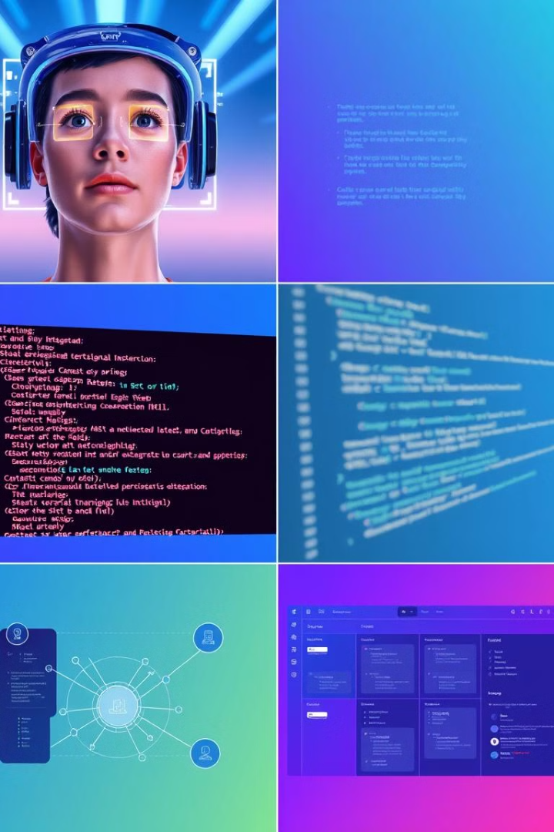




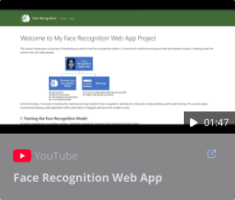
Challenges & Solutions
Face Recognition Accuracy
Integrating the Model
Preprocess images, use pre-trained models, and fine-tune with a custom dataset.
Serve the machine learning model in a web environment using a Flask API.
Scaling to Multiple Factors
Implement asynchronous processing and implementing to handle like differentiate it age , sentiments
Demo [demo alone]
Prepare Image
Face Registration
Prepare images
Upload your face data securely.
Identification Dashboard
View recognition results and insights.

Slide 13
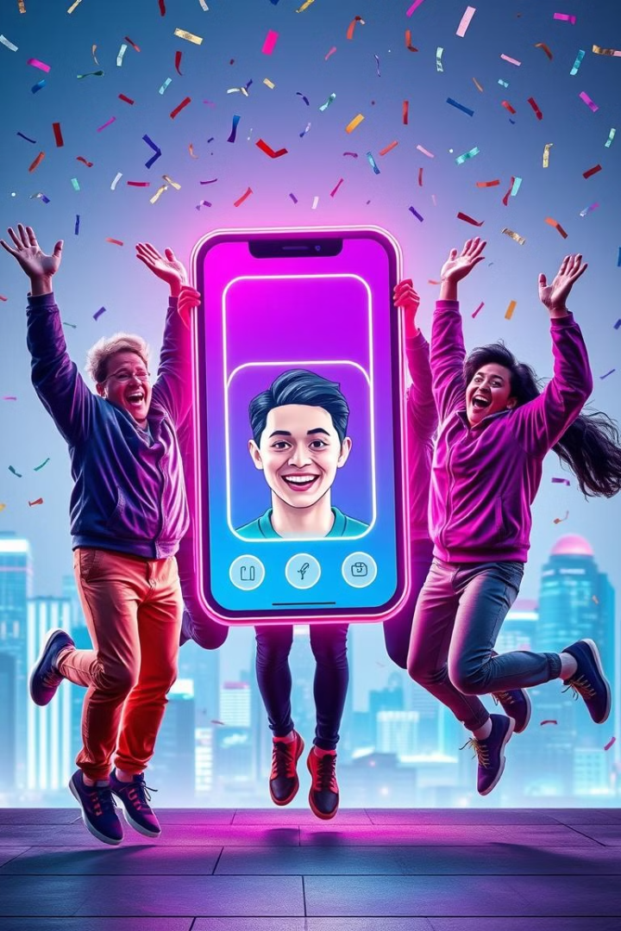
Thank You
I look forward to sharing the possibilities of face recognition and demonstrating the integration of AI and web technologies through this project! 🚀

